Slide 1

🚘 Why Ford Exited India (Twice): A Data-Driven Analysis
📅 1997–2021 | 📊 MySQL + Excel
By:Uday Arora

Slide 2

Project Objective
Goal: To explore Ford Motor Company’s exit from the Indian market using SQL and data analysis
Understand if they should have stayed based on:
Sales performance
Competition
Market conditions (fuel price, GST, etc.)
Export strategy

Slide 3

Key Questions We Asked
How did Ford perform in India over time?
How did Ford compare with competitors like Maruti, Hyundai, Tata?
Did high fuel prices and taxes push buyers away?
Was Ford using India only as a manufacturing hub?
Could Ford have stayed if they changed strategy?

Slide 4
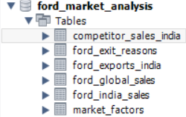
Data Sources Used
Database: Ford_market_analysis
Competitor_sales_india
Ford_exit_reasons
Ford_exports_india
Ford_global_sales
Ford_india_sales
Market_factor
Note: Some values, especially estimated revenue figures, were derived using publicly available sales data and average car prices. These are approximations and may not match official financial reports.

Slide 5
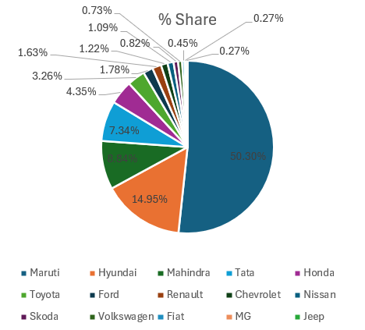
India’s Car Market Share Landscape: 1997–2021
This pie chart represents the cumulative market share of major automobile brands in India. Maruti dominates the market with over 50% share, followed by Hyundai and Mahindra. Ford's overall market share stands at 1.78%, reflecting its modest position despite being active for more than two decades in India.
Data Source: Aggregated from industry estimates and manufacturer data from 1997–2021. Disclaimer: The Ford sales figure of 1,312,505 units has been validated from multiple sources and may slightly vary from other published estimates.
Estimated figures based on public data

Slide 6
Ford vs Competitor Sales
Ford consistently sold fewer cars than major competitors like Maruti, Hyundai, and Tata — indicating weaker market presence over time.
Estimated figures based on public data

Slide 7
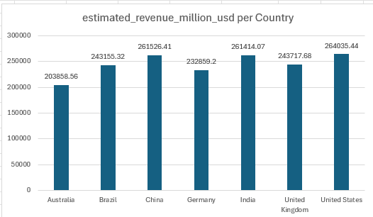
Total Revenue Comparison (1997–2021)
While Ford earned substantial revenue in India — nearly equal to its earnings in Brazil and Germany — it still chose to exit the market in 2021. This suggests that revenue alone was not the issue. Therefore, the subsequent analysis focuses on factors such as profitability, cost structures, competition, and government policies to uncover the real causes behind Ford’s decision.
Estimated figures based on public data

Slide 8
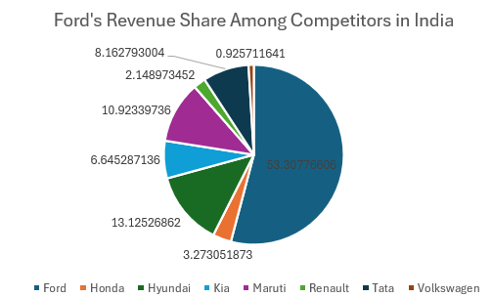
Ford's Revenue Share Among Competitors in India
Ford contributed over 53% of total estimated revenue among 8 major brands from 1997–2021, despite selling far fewer units.
This suggests Ford focused on high-value vehicles, but this premium pricing didn’t align with India’s cost-sensitive market.
Figures are based on publicly available and estimated data (Units Sold × Avg Price). Actual values may vary.

Slide 9
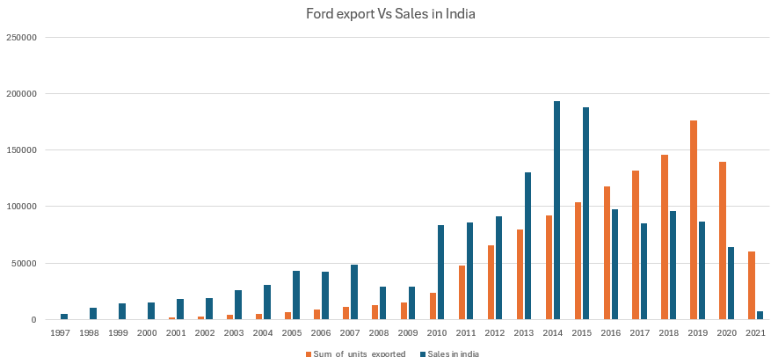
Ford in India: Export Hub or Domestic Player?
While Ford began as a domestic player, the trend clearly shifted post-2010. From 2013 to 2017, Ford exported significantly more cars than it sold in India — suggesting India was treated more as a manufacturing and export hub than a priority market.
Despite a strong domestic market potential, Ford’s focus on exports may have limited its local brand development and customer engagement — contributing to its eventual exit.
Insight: In many years, Ford exported more cars than it sold in India
Estimated figures based on public data

Slide 10
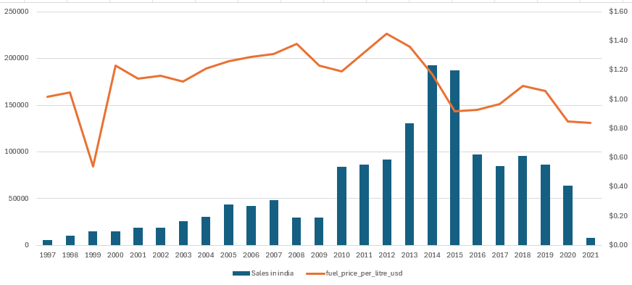
Market Headwinds: Correlation Between Ford Sales and Economic Factors
🧠 Key Observations:
🔼 2003–2014: Sales peaked even as fuel prices rose — strong product lineup.
🔽 Post-2014: Sales dropped sharply despite falling fuel prices.
❗ No strong correlation between fuel prices and Ford's performance.
🛑 2021: Sales dropped drastically as Ford exited India.
Estimated figures based on public data
🔍 “Fuel prices shown are per litre in USD. Sales are based on Ford’s annual vehicle deliveries in India.”

Slide 11
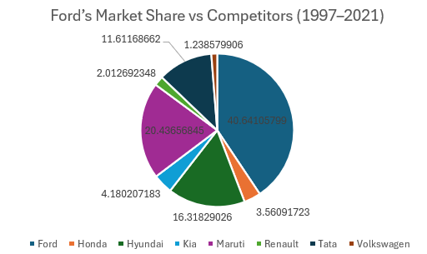
Ford’s Market Share Over 25 Years
Between 1997–2021, Ford sold only 40.43% as many units as its competitors combined — highlighting long-term underperformance in India’s competitive auto market.
Market share (%) $=\frac{Ford^{′}s Units sold}{Total Units Sold by All brands}×100=$ 40.43605 %
Total number of competitor_unit_sold = 1,992,000
Total number of Ford_unit_sold = 1,352,305
Estimated figures based on public data

Slide 12
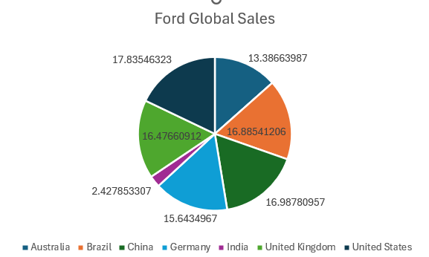
Global Perspective
Despite having lower sales in countries like Brazil (13.38%) and especially India (only 2.42%), Ford continued operations in other markets, some with similar challenges.
Ford remained operational in markets like Thailand, Vietnam, and South Africa despite challenges — showing they had different approaches by region.
🔍 India contributed just 2.42% to Ford’s global sales — yet Ford exited the Indian market, while continuing in countries like Brazil and Australia. This raises a question: Why did Ford not double down to improve performance in India like it did elsewhere?

Slide 13
India: A Tough Road for Global Automakers
Top Challenges Faced in India
🚗 Price-Sensitive Market
Majority of buyers opt for budget cars with high fuel efficiency.
🔧 High After-Sales Expectations
Affordable maintenance, widespread service network expected.
🏗️ Infrastructural Gaps
Roads and conditions favor small, rugged, fuel-efficient vehicles.
📜 Regulatory Complexity
Constant shifts in GST, safety norms, and emission standards.
🔄 Low Brand Loyalty
Indian buyers often switch brands based on short-term value.
Impact on Ford’s Strategy
🔹 Premium Pricing Limited Reach
Ford’s globally successful cars were priced too high for mass appeal.
🔹 Slow Localisation
Higher import content made Ford cars expensive vs rivals.
🔹 Low Volume, High Ambition
Couldn’t match sales volume of Maruti or Hyundai despite early entry.
🔹 Missed Trend Shifts
Late to respond to compact SUV trend and urban needs.
“Ford delivered global quality, but missed India’s value equation. Without affordability and localisation, scaling was tough”

Slide 14

Recommendations
🚗 1. Focus on Budget-Friendly Models
Reintroduce compact, fuel-efficient cars like Figo and Freestyle
Compete directly with Maruti, Tata, Hyundai in the small car segment
🛠️ 2. Use CKD/SKD Kit Assembly
Shift to Completely Knocked Down (CKD) or Semi Knocked Down (SKD) strategy
Significantly reduce manufacturing & import costs
⚡ 3. Enter India’s EV Market
Launch entry-level EVs aligned with India’s green transition
Compete with Tata (Nexon EV) and Mahindra’s electric lineup
🧰 4. Strengthen After-Sales Support
Improve service center availability
Focus on customer satisfaction, trust & branding

Slide 15
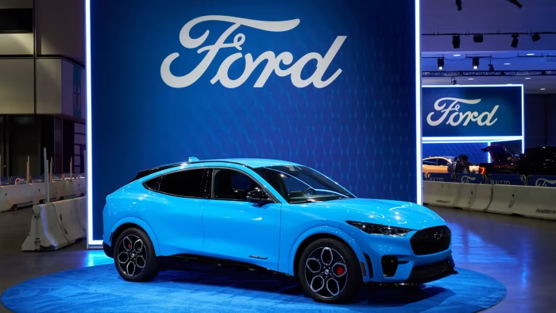
Conclusion
Ford exited India twice, the latest in 2021, despite 25+ years of presence.
Revenue analysis shows Ford held only ~53% of total revenue among major competitors.
Poor localization, lack of small car focus, weak after-sales were key reasons.
Competitors like Maruti, Tata, Hyundai succeeded with local production, EV push, and strong networks.

Slide 16
📜 Legally Framed Disclaimer (for India)
Disclaimer: This project is intended purely for academic and learning purposes. The data presented herein has been compiled from publicly available sources, industry estimates, and open reports to analyze business trends. While every effort has been made to ensure accuracy, some values — including revenue and market share — are estimated due to limitations in publicly disclosed data.
This work does not intend to cause harm, defame, or misrepresent any company, individual, or entity. No insult, critique, or allegation is made against Ford India or its stakeholders.
In accordance with the principles of freedom of speech and expression under Article 19(1)(a) of the Constitution of India, and as this falls under non-commercial academic use, the author assumes no liability for any errors, omissions, or interpretations of the data.
Should Ford Motor Company or any relevant party request clarification, removal, or correction of specific data points, the same will be duly reviewed and updated.
By viewing or sharing this project, it is understood that the information is not legally binding, and no commercial or defamatory intent is involved.

Slide 17
Sources and Reference Links (with Access Dates)
Wikipedia – Ford India History 🔗 https://en.wikipedia.org/wiki/Ford_India 📅 Accessed: March 15, 2025
Statista – Car Sales in India by Brand (2020–2021) 🔗 https://www.statista.com/statistics/1115856/india-car-sales-by-brand/ 📅 Accessed: March 15, 2025
Statista – Passenger Vehicle Sales Volume in India 🔗 https://www.statista.com/statistics/665695/india-passenger-vehicles-sales-volume/ 📅 Accessed: March 15, 2025
Reuters – Ford India Exit Report (2021) 🔗 https://www.reuters.com/business/autos-transportation/ford-move-india-restructure-costs-2021-09-09/ 📅 Accessed: March 15, 2025
CarDekho – Ford Car Prices in India (Archived) 🔗 https://www.cardekho.com/cars/Ford 📅 Accessed: March 15, 2025
AutoCar India – Market Share of Carmakers in India 🔗 https://www.autocarindia.com/car-news/indian-car-market-share-in-2021-420406 📅 Accessed: March 15, 2025
ET Auto (Economic Times) – Ford India exit analysis 🔗 https://auto.economictimes.indiatimes.com/news/passenger-vehicle/cars/why-ford-decided-to-leave-india/86040755 📅 Accessed: March 15, 2025
15, 2025

Slide 18
Sources and Reference Links (with Access Dates)
Society of Indian Automobile Manufacturers (SIAM) 🔗 https://www.siam.in/statistics.aspx?mpgid=8&pgidtrail=14 📅 Accessed: March 15, 2025
World Bank – Ease of Doing Business Index (India) 🔗 https://data.worldbank.org/indicator/IC.BUS.EASE.XQ?locations=IN 📅 Accessed: March 15, 2025
Trading Economics – India Corporate Tax Rate 🔗 https://tradingeconomics.com/india/corporate-tax-rate 📅 Accessed: March 15, 2025
India Today – Fuel Prices in India (Historical) 🔗 https://www.indiatoday.in/fuel-prices 📅 Accessed: March 15, 2025
Ford Annual Report (Global) – FY2021 🔗 https://corporate.ford.com/investors/reports/annual-reports.html 📅 Accessed: March 15, 2025
AutoPunditz – Monthly Car Sales Data in India (Ford & Competitors) 🔗 https://www.autopunditz.com/ 📅 Accessed: March 15, 2025
Financial Express – Ford Exports from India 🔗 https://www.financialexpress.com/auto/car-news/ford-exits-india-still-exports-from-chennai/2322681/ 📅 Accessed: March 15, 2025

